Slide 1
17.3 Acid-Base Titrations

Slide 2
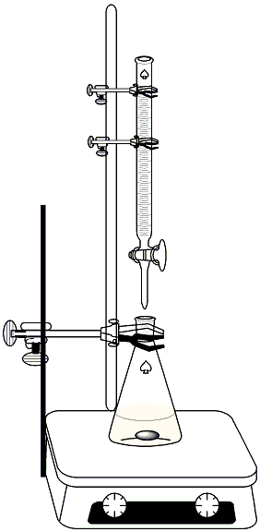
17.3 Acid Base Titrations
Titrations
Very common analytical test to determine concentrations of unknown solutions
Typically done by adding a known concentration (standardized) of base to acid
Can be done with indicator or pH meter set up to read pH or volts

Slide 3
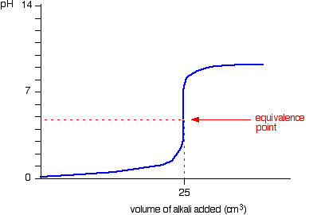
17.3 Titration Curves
Titration curves are more accurate way to conduct titrations because the exact equivalence point can be determined by extrapolating the graph
Equivalence point – the point in titration where acid and base are neutralized and equal

Slide 4
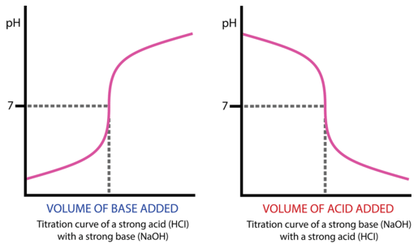
17.3 Strong Acid – Base Curves

Slide 5
17.3 Strong Acid – Base Titration
Practice: Calculate the pH when the following quantities of 0.100 M NaOH solution have been added to 50.0 mL of 0.100 M HCl
A. 49.0 mL
B. 51.0 mL

Slide 6
17.3 Strong-Acid Base
Practice:
A titration of 25.0 mL of HCl with 0.00105 M NaOH standardized. The first sign of color change (equivalence point) occurs after the addition of 15.5 mL of NaOH.
What is the concentration of the HCl?

Slide 7
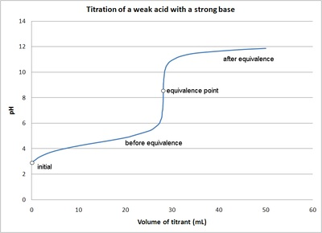
17.3 Weak Acid Base Titrations
Weak acid – base titration curves look very similar…
Things that are different
They start higher on the scale than strong acid-base titrations
The rapid rise at the equivalence point is not as drastic as strong acid-base
Equivalence point is not at 7!

Slide 8
17.3 Weak Acid Base Titrations
Let’s take a look at an example….
Titration of 50.0 mL of 0.100 M acetic acid with
0.100 NaOH
Let’s break this up into 4 portions
1.) Initial pH – below 7, can be determined using techniques from chapter 16 (2.89)
2.) Between initial pH and the equivalence point – slow rise as H+ ions are neutralized
3.) The equivalence point – a rapid rise in pH, but not as drastic as SA and SB
4.) After the equivalence point – greater than 7 (C2H2O2- is a weak base)

Slide 9
17.3 Weak Acid Base Titrations
Practice:
Calculate pH of the solution formed when 45.0 mL of 0.100 M NaOH is added to 50.0 mL of 0.100 M HC2H3O2

Slide 10
17.3 Polyprotic Acids
Polyprotic weak acids such as H3PO3, when titrated, occur in a series of steps
For these types of titrations, 2 sets of properly chosen indicators would be necessary
For indicators, they need to be chosen to respond to changes near the equivalence point, they don’t have to be exact

Slide 11
Types of Titrations

